Slide 1

人工智能导论 Introduction To Artificial Intelligence
Search
王进
成都大学信息科学与工程学院
Notes:
Introduce self again.
Build agents that plans ahead. Act rationally.

Slide 2
Recap:Agent 内容回顾
What is AI
What is rational decision
What is rational agent

Slide 3
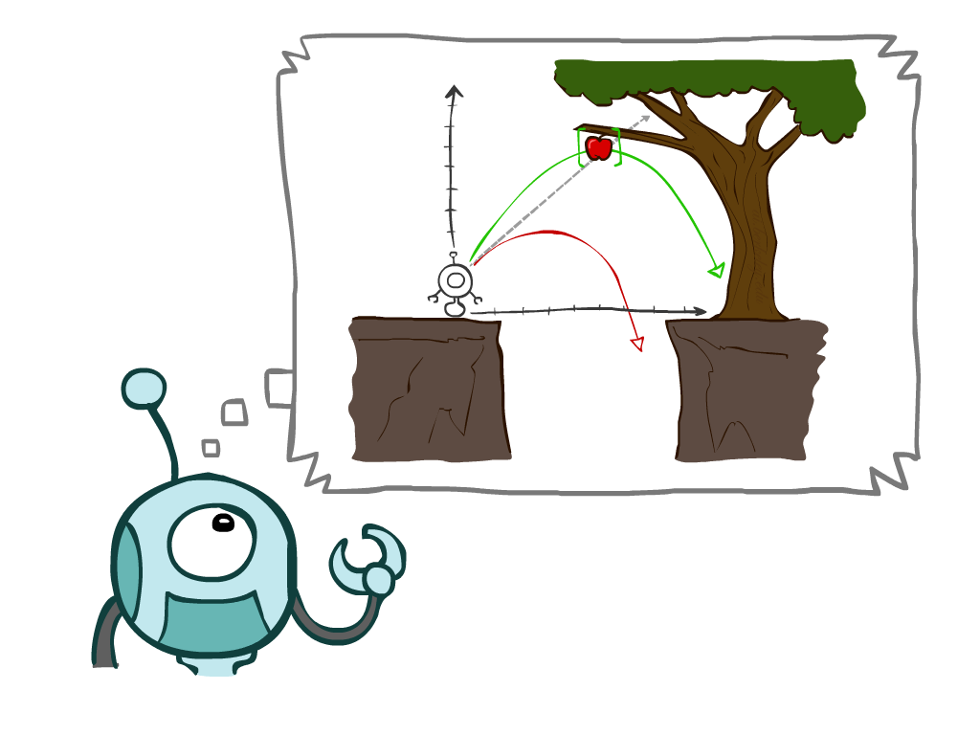
Today
Agents that Plan Ahead代理
Search Problems搜索问题
Uninformed Search Methods盲搜索
Depth-First Search深度优先
Breadth-First Search宽度优先
Uniform-Cost Search一致代价搜索
Notes:
Many you have seen before.
Unified formalism leading to A* search (search guided by heuristic)

Slide 4
Agents that Plan
Notes:
Why agents plan? If/then code. Hard to do.
Move to the apple

Slide 5

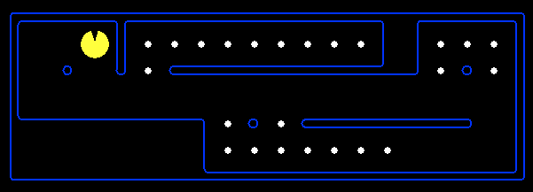
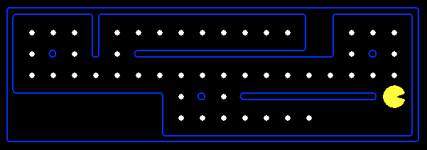
Reflex Agents反射代理
Reflex agents:
Choose action based on current percept (and maybe memory)基于当前感知选择行为
May have memory or a model of the world’s current state存储当前状态或对当前状态建模
Do not consider the future consequences of their actions不考虑将来结果
Consider how the world IS 只考虑眼下
Can a reflex agent be rational? 反射代理是理性的吗？
[Demo: reflex optimal (L2D1)]
[Demo: reflex optimal (L2D2)]
Notes:
Fall; bad idea;
Reflex – lookup from state to action. Don’t consider the future consequences of your actions
Examples: blinking your eye (not using your entire thinking capabilities), vacuum cleaner moving towards nearest dirt
Can a reflex agent be rational?

Slide 6
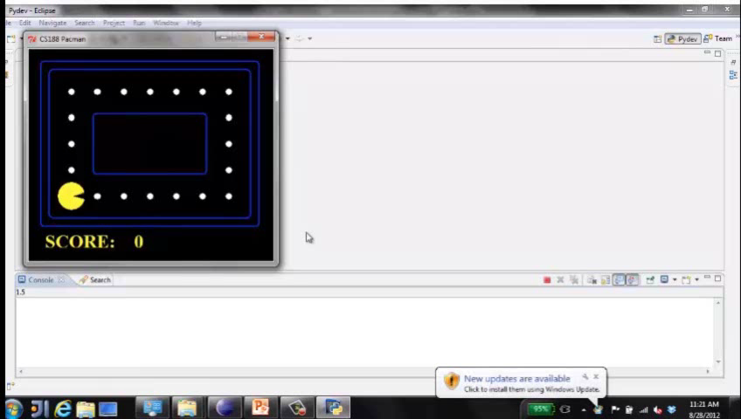
Video of Demo Reflex Optimal
Notes:
L2D1
Move in the direction of the nearest uneaten dot. You can think ahead all you want, still end up doing the same thing.
Can be rational.

Slide 7
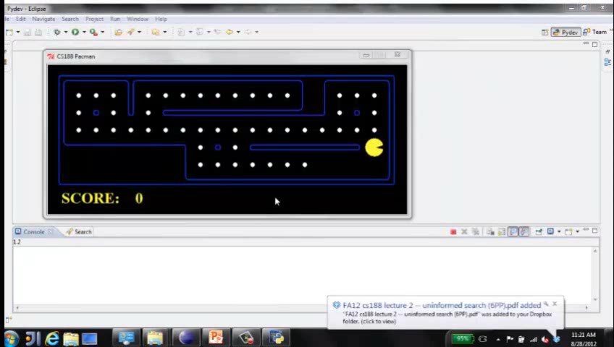
Video of Demo Reflex Odd
Notes:
L2D2
NO planning. Wall between you and nearest dot?
Reflex agents not generally optimal, but they can be depending on circumstance.
Optimality is not defined by algorithm, but by rational behavior.

Slide 8
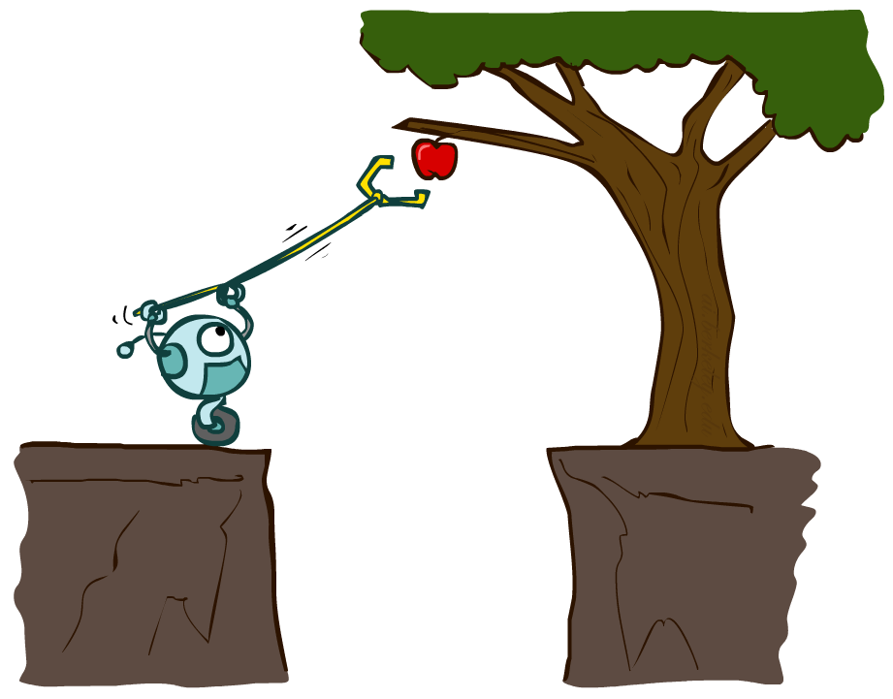
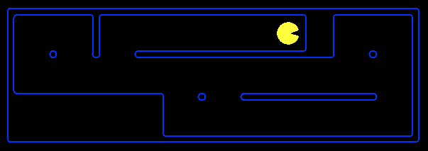
Planning Agents规划代理
Planning agents:
Ask “what if”问“如果..就..”的问题
Decisions based on (hypothesized) consequences of actions决策基于假定行为结果
Must have a model of how the world evolves in response to actions 需要建立环境演化模型
Must formulate a goal (test)需要给出目标
Consider how the world WOULD BE
Optimal最好 vs. complete planning可行
Planning规划 vs. replanning再规划
[Demo: re-planning (L2D3)]
[Demo: mastermind (L2D4)]
Notes:
You cold figure out the consequences by doing it. But instead, planning considers what the world would be without actually doing it.
Simulate many games, execute one. Doesn’t do it in the world, does it in the model.
Consequences of action.
Complete – a solution; optimal – best

Slide 9
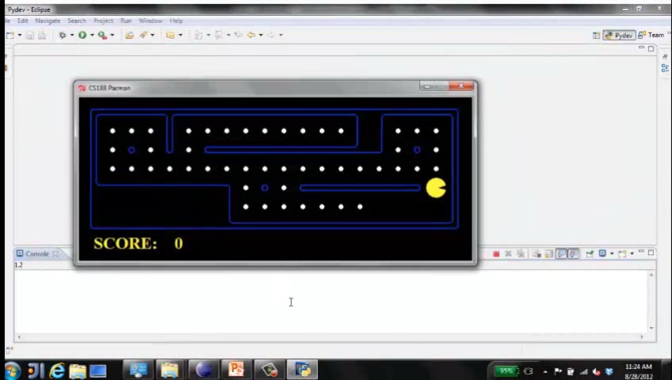
Video of Demo Replanning
Notes:
L2D3, replanning. Figure out how to get to next dot. Clears board; non-optimal. Fast.

Slide 10
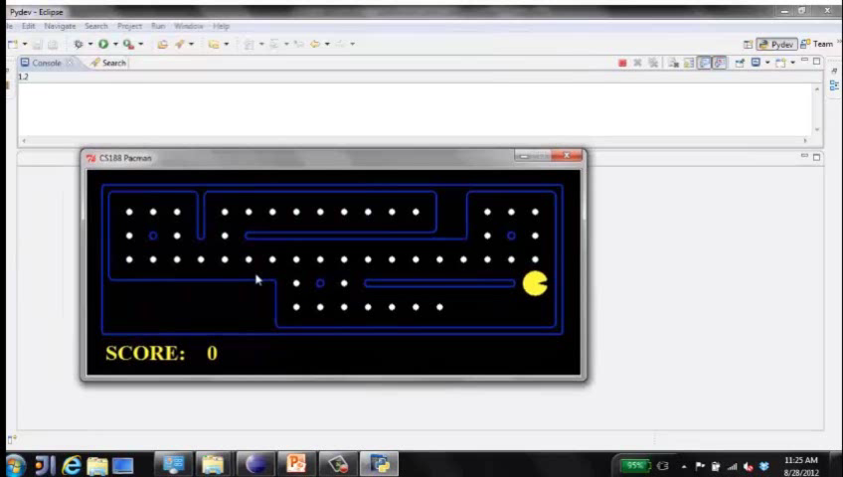
Video of Demo Mastermind 巧妙计划
Notes:
L2D4, mastermind. Thinking, thinking, thinking…
Not just clear NEXT dot, but all dots.
Know to end with dead end so it doesnt have to back up

Slide 11

Search Problems搜索问题
Notes:
How do we formalize a search problem?

Slide 12

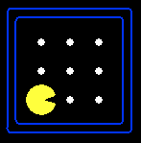





Search Problems
A search problem consists of搜索问题通常包括:
A state space
状态空间
A successor function
(with actions, costs)
转换函数（输入是所采取行为
及其代价，输出是下一个状态）
A start state and a goal test
起始状态和目标状态
A solution is a sequence of actions (a plan) which transforms the start state to a goal state 一个解决方案是一串动作序列，将起始状态转换为目标状态。
“N”, 1.0
“E”, 1.0
Notes:
Abstraction. Useful for later topics.
Goal test – sometimes more than one state that satisfies having achieved the goal, for example, “eat all the dots”

Slide 13

Search Problems Are Models
Notes:
Models aren’t perfect.
Too detailed, you can’t solve.
Not detailed enough, doesn’t solve.

Slide 14
Example: Traveling in Romania罗马尼亚旅行
State space状态空间:
Cities城市
Successor function转换函数:
Roads: Go to adjacent city with cost = distance 以到邻近城市的路长度为代价
Start state起始状态:
Arad
Goal test目标测试:
Is state == Bucharest?
Solution?
Notes:
Traffic, gas, accidents, time of day, etc.
Bit of art figuring out state space, etc.

Slide 15
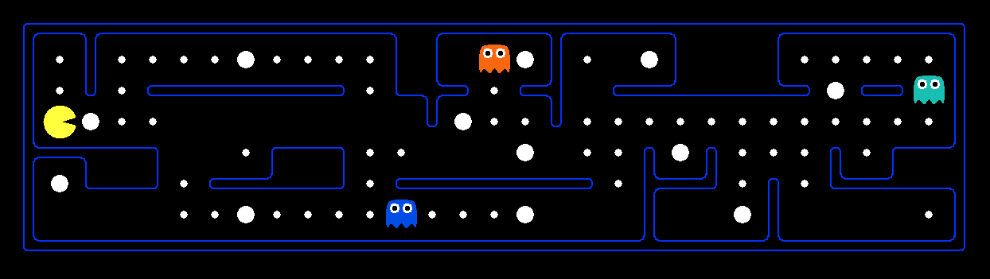
What’s in a State Space?状态空间包括什么
The world state includes every last detail of the environment理想状态应包括所处环境的一切细节
A search state keeps only the details needed for planning (abstraction) 搜索状态进一步简化，仅保留规划必须的细节
Problem: Pathing
States状态: (x,y) location
Actions: NSEW东南西北
Successor转换函数: update location only仅更新位置
Goal test: is (x,y)=END
Problem: Eat-All-Dots
States: {(x,y), dot booleans}
Actions: NSEW
Successor: update location and possibly a dot boolean
Goal test: dots all false
Notes:
Wrong example for “eat-all-dots”: (x, y, dot count). Need bool.
World >= State
Walls? Part of successor.

Slide 16
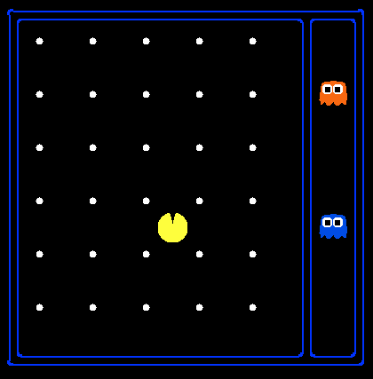
State Space Sizes状态空间大小?
World state理想状态:
Agent positions代理位置数: 120
Food count豆子数: 30
Ghost positions幽灵位置数: 12
Agent facing代理行为空间: NSEW
How many状态数量
World states理想状态数量?
120x(2³⁰)x(12²)x4
States for pathing寻路问题状态数?
120
States for eat-all-dots“吃掉所有豆子”问题状态数?
120x(2³⁰)
Notes:
12x10 grid

Slide 17
Case: Safe Passage安全通过问题
Problem: eat all dots while keeping the ghosts perma-scared
What does the state space have to specify?状态空间如何设计
(agent position代理位置, dot booleans豆子布尔变量, power pellet booleans小球能量布尔变量, remaining scared time剩余恐惧时间)
Notes:
Eat power pellets. Ignore ghost reset. What do you need in state space?
Do you need ghost positions?
What’s in the state vs. successor function?

Slide 18

State Space Graphs and Search Trees 状态空间与搜索树
Notes:
~30 minutes
Solving only uses state space, successor, etc. Not power pellets, dots, etc.

Slide 19
State Space Graphs状态空间图
State space graph搜索图: A mathematical representation of a search problem搜素问题的数学描述
Nodes are (abstracted) world configurations状态
Arcs represent successors (action results)转换函数
The goal test is a set of goal nodes (maybe only one)目标测试包括多个目标节点
In a state space graph, each state occurs only once! 状态空间途中，每个状态只能出现1次
We can rarely build this full graph in memory (it’s too big), but it’s a useful idea 状态数量巨大，几乎不可能在有限存储中记录完整状态空间图
Notes:
ASR: every possible pronunciation of every possible sentence. Huge.

Slide 20
State Space Graphs状态空间图
State space graph搜索图: A mathematical representation of a search problem搜素问题的数学描述
Nodes are (abstracted) world configurations状态
Arcs represent successors (action results)转换函数
The goal test is a set of goal nodes (maybe only one)目标测试包括多个目标节点
In a state space graph, each state occurs only once! 状态空间途中，每个状态只能出现1次
We can rarely build this full graph in memory (it’s too big), but it’s a useful idea 状态数量巨大，几乎不可能在有限存储中记录完整状态空间图
a
G
b
c
e
d
f
S
h
p
q
r
Tiny search graph for a tiny search problem
Notes:
Find solution without writing most of the graph down.
really care about the start and what you can do from the start -> search tree

Slide 21
Search Trees搜索树
This is now / start
“N”, 1.0
“E”, 1.0
Possible futures
A search tree搜索树:
A “what if” tree of plans and their outcomes
The start state is the root node起始状态是根节点
Children correspond to successors孩子对应转换函数
Nodes show states, but correspond to PLANS that achieve those states节点代表状态，但同时代表到达该状态的路径
For most problems, we can never actually build the whole tree 很多情况下，几乎不可能构建完整搜索树
Notes:
Different plans that achieve the same state, will be different nodes in the tree.
Every plan in the tree.
Search ignores most of the tree.

Slide 22
State Space Graphs vs. Search Trees
State Space Graph
Each NODE in in the search tree is an entire PATH in the state space graph.
Search Tree
S
a
G
d
e
p
b
c
q
b
c
e
h
r
d
e
f
a
a
h
r
p
q
f
S
h
We construct both on demand – and we construct as little as possible.
p
q
f
q
c
G
p
q
r
q
c
G
a
a

Slide 23

State Space Graphs vs. Search Trees
Consider this 4-state graph:
How big is its search tree (from S)?
a
S
G
b
Important: Lots of repeated structure in the search tree! 通常搜索数中存在很多循环结构
Notes:
MISSING ANIMATION

Slide 24
State Space Graphs vs. Search Trees
Consider this 4-state graph:
How big is its search tree (from S)?
a
S
G
b

Slide 25
State Space Graphs vs. Search Trees
Consider this 4-state graph:
How big is its search tree (from S)?
a
s
a
b
S
G
b
G
a
G
b
a
G
b
G
…
…
Important: Lots of repeated structure in the search tree! 通常搜索数中存在很多循环结构
Notes:
Graph is only 4, tree is infinite!

Slide 26
Tree Search
Notes:
That’s the abstraction. Now talk about algorithm.

Slide 27
Search Example: Romania案例分析

Slide 28
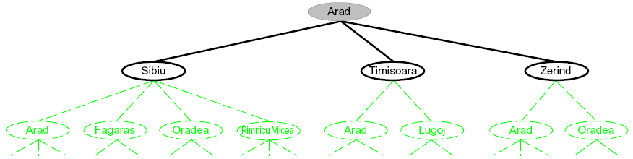
Searching with a Search Tree利用搜索树搜索
Search搜索过程:
Expand out potential plans (tree nodes)展开潜在树节点
Maintain a fringe of partial plans under consideration 额外维护一个待展开节点队列
Try to expand as few tree nodes as possible 展开的树节点尽量少
Notes:
Haven’t constructed green stuff yet. It exists and is mathematically defined, but we haven’t actually constructed it / explored it yet.
Build downward.

Slide 29
General Tree Search搜索树基本流程
Important ideas关键:
Fringe 额外队列
Expansion 展开
Exploration strategy 探索策略
Main question关键问题: which fringe nodes to explore?如何选择下一个展开节点
Notes:
Pseudo-code. General algorithm. Some details specific to later topics, notably A*.

Slide 30
Example: Tree Search
a
G
b
c
d
e
f
S
h
p
q
r
Notes:
Tiny example. Here’s the state graph. Walk through tree search.
Left: show tree. Not typically stored, but implicit.
Right: fringe. Key data structure.

Slide 31
Example: Tree Search
a
G
b
c
e
d
e
d
f
f
S
h
p
r
q
r
S
s
s → d
s → e
s → p
s → d → b
s → d → c
s → d → e
s → d → e → h
s → d → e → r
s → d → e → r → f
s → d → e → r → f → c
s → d → e → r → f → G
d
e
p
b
c
e
h
r
q
a
a
h
r
p
q
f
p
q
f
q
c
G
q
c
G
a
a
Notes:
For example, strategy is arbitrary.
S D E R F G
Don’t return until G removed. Not when G added. Important later.
188-guided-search; in general we don’t have 188 on call to tell us what to expand next

Slide 32

Depth-First Search深度优先搜索
Notes:
That was generic. Now specific strategy – dfs
Go deep!
Exponentially large at the bottom.

Slide 33
Depth-First Search深度优先搜索
Strategy: expand a deepest node first优先展开最深的节点
Implementation: Fringe is a LIFO stack采用后入现出的堆栈结构
a
G
a
c
b
c
b
e
d
e
d
f
f
S
h
h
p
p
r
q
r
q
S
d
e
p
b
c
e
h
r
q
a
a
h
r
p
q
f
p
q
f
q
c
G
q
c
G
a
a
Notes:
S D B A C A E H P Q
Ties alphabetically in this case.

Slide 34
Search Algorithm Properties搜索算法属性
Complete完备性: Guaranteed to find a solution if one exists?能否保证发现最终解
Optimal最优性: Guaranteed to find the least cost path?能否保证找到最小代价路径
Time complexity时间复杂性?
Space complexity空间复杂性?
Cartoon of search tree假定树:
b is the branching factor分支因子
m is the maximum depth最大深度
solutions at various depths 每层都有解
Number of nodes in entire tree?整个树的节点数
1 + b + b² + …. b^{m} = O(b^{m})
1 node
b
…
b nodes
b² nodes
m tiers
b^{m} nodes
Notes:
Questions about search algoirthms.
Simple cartoony case – assume each node is state space connects to exactly b other nodes.
Since doing bound estimation, we’re correct as long as fewer than b.
Infinite?

Slide 35
Depth-First Search (DFS) Properties
What nodes DFS expand? DFS展开的节点
Some left prefix of the tree. 树的左侧
Could process the whole tree! 亦可能展开所有节点
If m is finite, takes time O(b^{m})
How much space does the fringe take?存储空间
Only has siblings on path to root, so O(bm)
Is it complete?完备性
m could be infinite, so only if we prevent cycles (more later) 在没有环存在情况下，是的
Is it optimal? 最优性
No, it finds the “leftmost” solution, regardless of depth or cost不是最优，只能发现左侧的解
1 node
b
…
b nodes
b² nodes
m tiers
b^{m} nodes
Notes:
Process whole tree if goal is lower right.
Space: At each level, children of one node at most on fringe, so b. Times number of layers m. (Small!)

Slide 36
Recap: last Class 回顾
Agents plan ahead
Rational
How to Describe Search Problem
State Space
Successor function
Initial state & Goal state
State Space Graph & Searching Tree
Depth-First Search

Slide 37
Depth-First Search (DFS) Properties
What nodes DFS expand? DFS展开的节点
Some left prefix of the tree. 树的左侧
Could process the whole tree! 亦可能展开所有节点
If m is finite, takes time O(b^{m})
How much space does the fringe take?存储空间
Only has siblings on path to root, so O(bm)
Is it complete?完备性
m could be infinite, so only if we prevent cycles (more later) 在没有环存在情况下，是的
Is it optimal? 最优性
No, it finds the “leftmost” solution, regardless of depth or cost不是最优，只能发现左侧的解
1 node
b
…
b nodes
b² nodes
m tiers
b^{m} nodes
Notes:
Process whole tree if goal is lower right.
Space: At each level, children of one node at most on fringe, so b. Times number of layers m. (Small!)

Slide 38
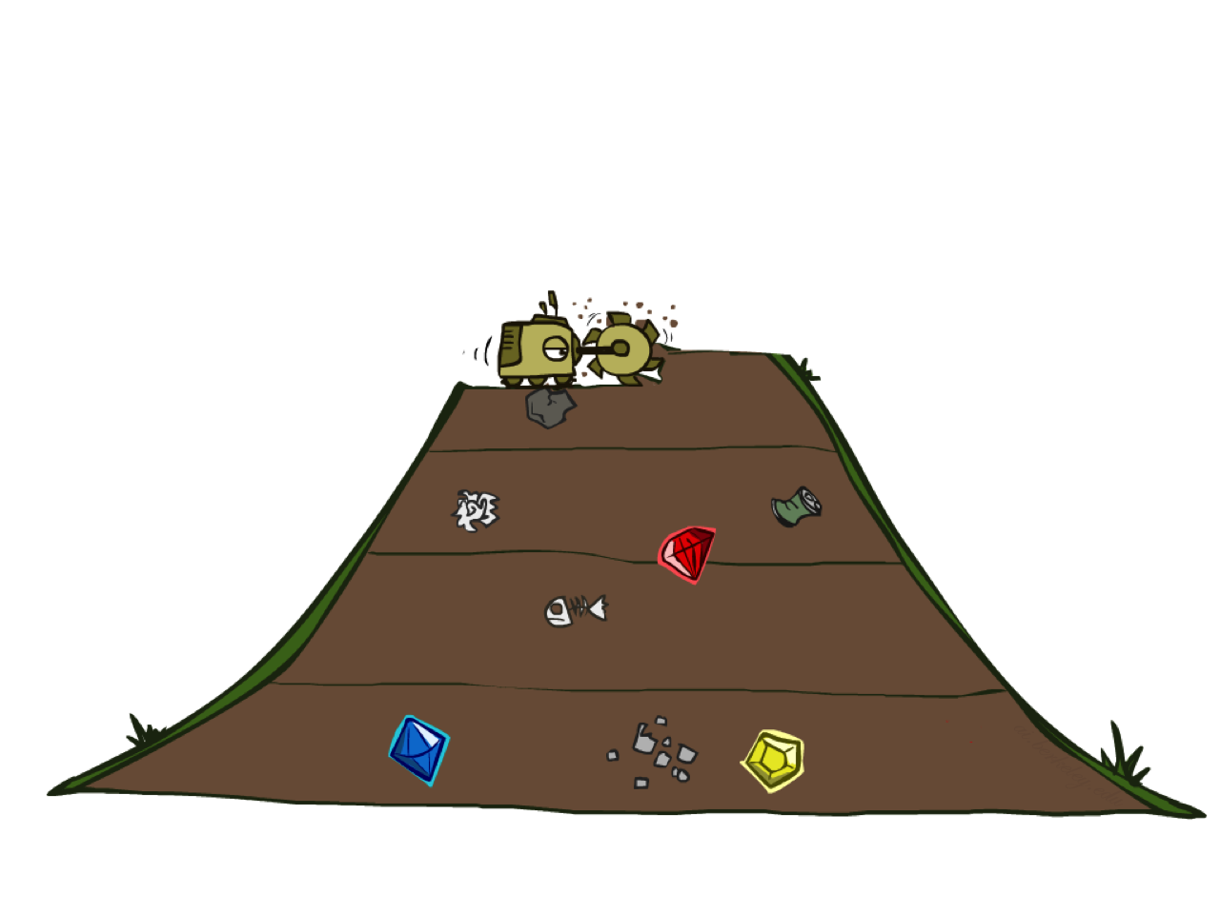
Next: Breadth-First Search宽度优先搜索
Notes:
Another strategy. Layer by layer.
Strip-mining
BFS

Slide 39
Breadth-First Search宽度优先搜索
Strategy: expand a shallowest node first有限展开最浅节点
Implementation: Fringe is a FIFO queue
采用先入先出队列
a
G
b
c
d
e
f
S
h
p
q
r
S
d
e
p
Search
Tiers
b
c
e
h
r
q
a
a
h
r
p
q
f
p
q
f
q
c
G
q
c
G
a
a
Notes:
Same general algorithm. Shallowest node.
S D E P B C E H R Q

Slide 40
Breadth-First Search (BFS) Properties
What nodes does BFS expand?展开节点
Let depth of shallowest solution be s 假定深度最浅的解是s
Processes all nodes above shallowest solution 所有深度小于s的节点都会被展开
Search takes time O(b^{s})时间复杂性
How much space does the fringe take?空间复杂性
Has roughly the last tier, so O(b^{s})
Is it complete?完备性
s must be finite if a solution exists, so yes!
Is it optimal?最优性
Only if costs are all 1 (more on costs later)
1 node
b
…
b nodes
s tiers
b² nodes
b^{s} nodes
b^{m} nodes
Notes:
Tier of best solution. If on right, b^s. Exponential Big.

Slide 41
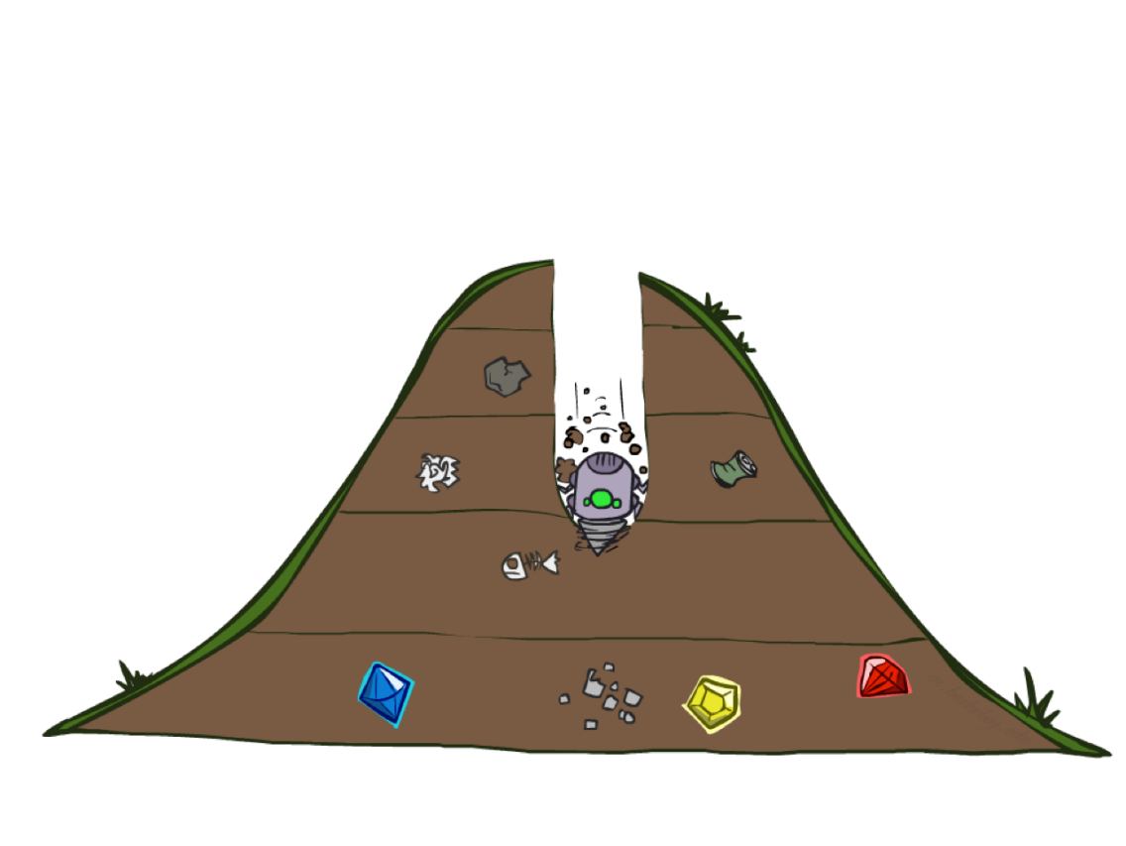
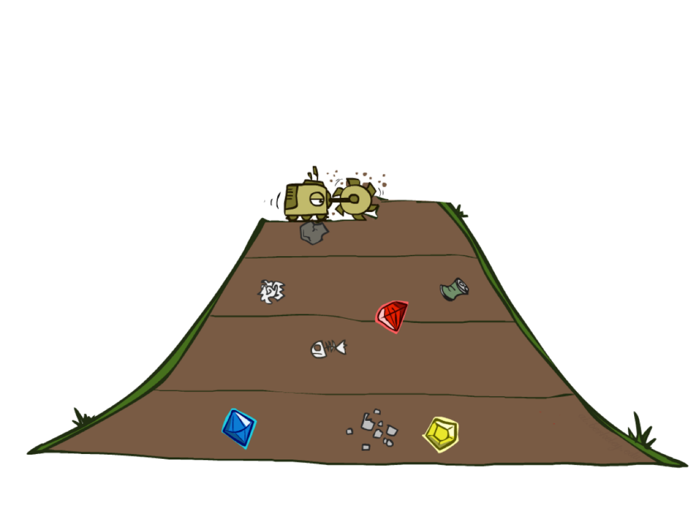
Quiz: DFS vs BFS
Notes:
Compare the two.

Slide 42
DFS vs BFS
When will BFS outperform DFS?
When will DFS outperform BFS?
[Demo: dfs/bfs maze water (L2D6)]
Notes:
Think about it a bit. Discuss with neighbor.
BFS: Solutions not too far down.
DFS: need to get to the bottom. Memory constrained.

Slide 43

Video of Demo Maze Water DFS/BFS (part 1)
Notes:
L2D6 – Boats in water. States light up first time explored. Which one?
Breadth

Slide 44
Video of Demo Maze Water DFS/BFS (part 2)
Notes:
Depth
Leftmost not very good!

Slide 45
Iterative Deepening迭代加深
Idea: get DFS’s space advantage with BFS’s time / shallow-solution advantages结合DFS空间优势和BFS时间优势
Run a DFS with depth limit 1. If no solution…
Run a DFS with depth limit 2. If no solution…
Run a DFS with depth limit 3. …..
Isn’t that wastefully redundant?会不会浪费
Generally most work happens in the lowest level searched, so not so bad! 通常不会，解对多位于较浅的层
b
…
Notes:
Another strategy. Combine best of both.
DFS – successor says if deeper than one, stop.
Really common.

Slide 46
Cost-Sensitive Search代价敏感搜索
a
GOAL
2
2
b
c
3
2
1
8
2
e
d
f
3
9
8
2
START
h
1
4
2
p
4
r
15
q
BFS finds the shortest path in terms of number of actions.
It does not find the least-cost path. We will now cover
a similar algorithm which does find the least-cost path.
How?
Notes:
“Cost Search” What if you have costs associated with arcs? Could you rewrite with what we already know?
Lowest number of actions S->e->r->f->G. Expensive!

Slide 47

Uniform Cost Search一致代价搜索
Notes:
Unfortunate name. It’s a “cost search” that is uniform, not a uniform cost.
Instead of depth, go by cost. Cheap things first, even if multiple actions.

Slide 48
Uniform Cost Search一致代价搜索
2
G
a
Strategy: expand a cheapest node first: 代价最小的节点优先
Fringe is a priority queue (priority: cumulative cost) 优先队列
b
c
1
8
2
2
e
3
d
f
9
8
2
S
h
1
1
p
q
r
15
0
S
d
3
e
9
p
1
b
4
e
5
h
17
r
11
q
16
c
11
Cost contours
a
6
a
h
13
r
7
p
q
f
p
q
f
8
q
c
G
q
c
a
11
G
10
a
Notes:
Like breadth first, but with costs. Label with cumulative cost.
Goal path not victory until try to expanded.
Contours show equal cost.

Slide 49
Uniform Cost Search (UCS) Properties
What nodes does UCS expand?展开哪些节点
Processes all nodes with cost less than cheapest solution!所有代价小于解的节点都将被展开
If that solution costs C* and arcs cost at least ε , then the “effective depth” is roughly C*/ε
Takes time O(b^{C*/ε}) (exponential in effective depth)时间复杂性
How much space does the fringe take?空间复杂性
Has roughly the last tier, so O(b^{C*/ε})
Is it complete?
Assuming best solution has a finite cost and minimum arc cost is positive, yes!
Is it optimal?
Yes! (Proof next lecture via A*)
b
c ≤ 1
…
c ≤ 2
C*/ε “tiers”
c ≤ 3
Notes:
Let’s say C* is 10 and minimum step size is 2. How deep in the tree? C*/e = 5. How many nodes is that?

Slide 50
Uniform Cost Issues
Remember: UCS explores increasing cost contours UCS朝代价轮廓的径向探索
The good优势: UCS is complete and optimal! UCS是完备的、最优的
The bad不足:
Explores options in every “direction” “东一下，西一下”
No information about goal location 缺乏目标位置信息
We’ll fix that soon!
…
c ≤ 1
c ≤ 2
c ≤ 3
Start
Goal
[Demo: empty grid UCS (L2D5)]
[Demo: maze with deep/shallow water DFS/BFS/UCS (L2D7)]
Notes:
What if you know the goal?

Slide 51
Video of Demo Empty UCS
Notes:
L2D5
Then L2D7, Breadth, Uniform, Depth

Slide 52
Video of Demo Maze with Deep/Shallow Water --- DFS, BFS, or UCS? (part 1)
Notes:
Let students guess which one of the three it is. (This is BFS.)
L2D7 B U D

Slide 53
Video of Demo Maze with Deep/Shallow Water --- DFS, BFS, or UCS? (part 2)
Notes:
Let students guess which one of the three it is. (This is UCS.)
expansion slows down when you hit deep water

Slide 54
Video of Demo Maze with Deep/Shallow Water --- DFS, BFS, or UCS? (part 3)
Notes:
Let students guess which one of the three it is. (This is DFS.)
<3 dfs

Slide 55
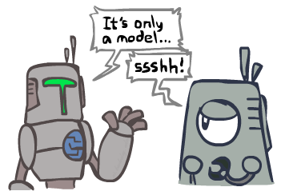
Search and Models搜索与模型
Search operates over models of the world搜索是基于实际场景的模型
The agent doesn’t actually try all the plans out in the real world!代理不会在真实场景中试所有规划
Planning is all “in simulation”规划实际是仿真
Your search is only as good as your models… 搜索性能取决于模型设计
Notes:
All in your head.

Slide 56
课后
阅读教材3.1-3.4
项目1：传教士与野人问题（3月27号晚上12点之前将项目报告、代码发到jwangdr@aliyun.com）

